Slide 1
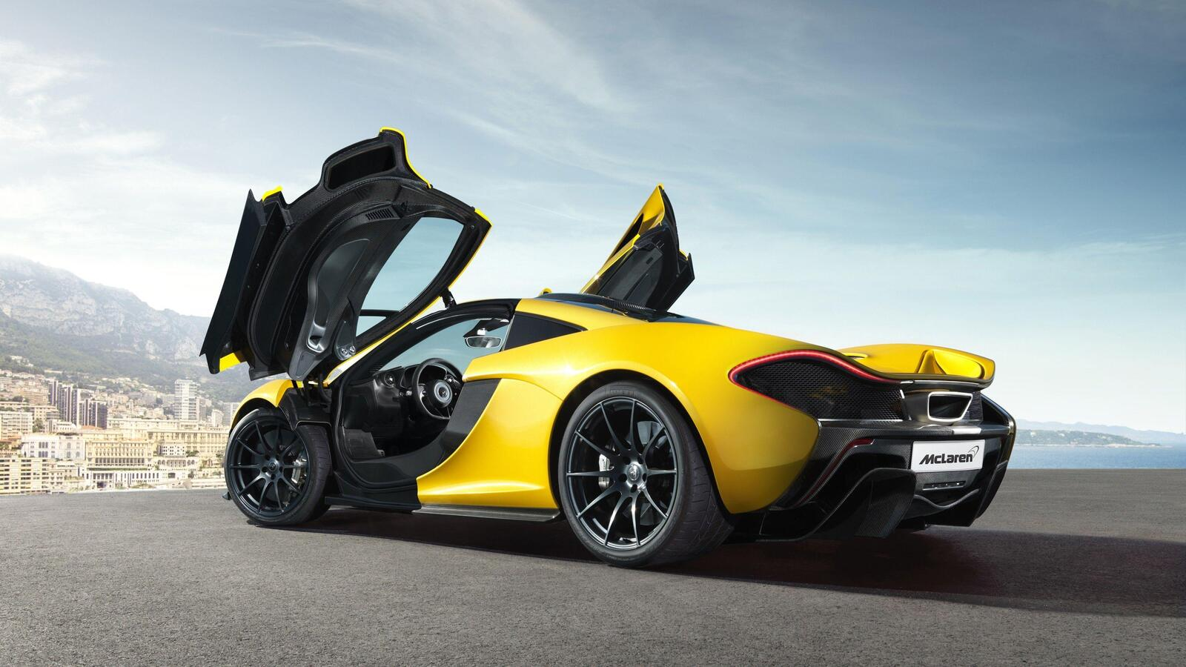
CAR DATA ANALYSIS
- SIVASREE MANOGAR

Slide 2
Insights Summary
General Data Analysis Questions
KPI-Based Questions
Pivot Table Analysis Questions
SUMIFS, COUNTIFS, AVERAGEIFS, MINIFS, MAXIFS Questions

Slide 3
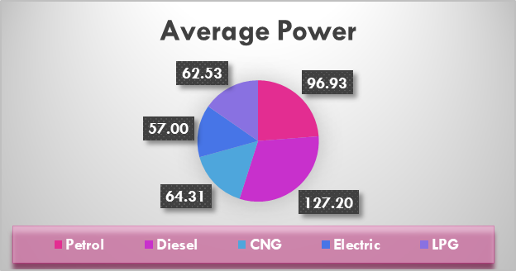
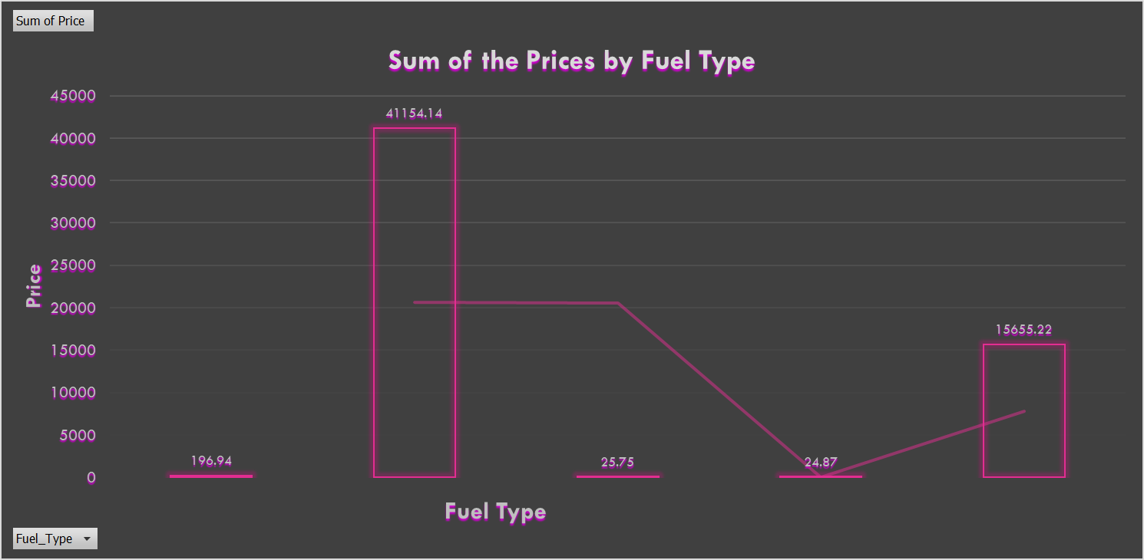
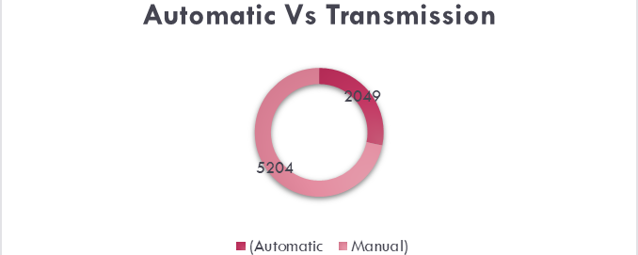
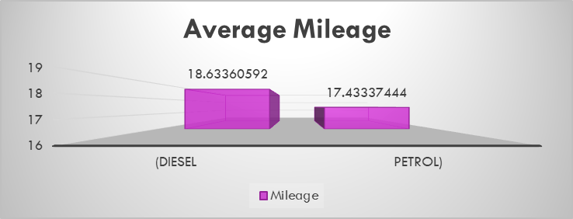
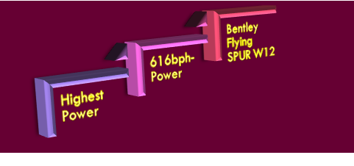
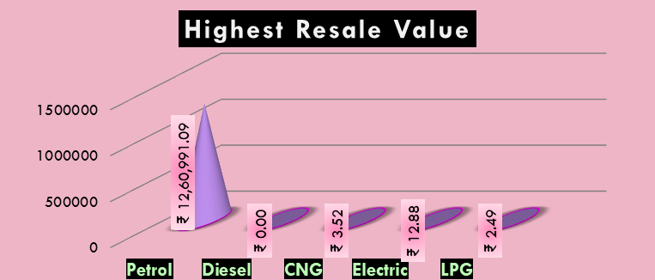
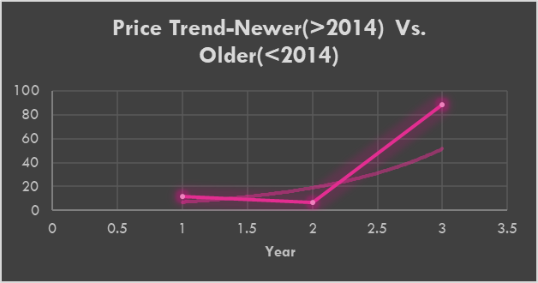
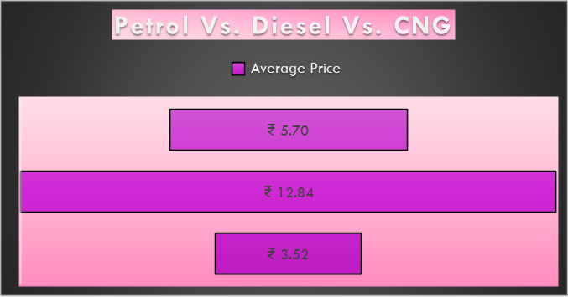
Dashboard
Lowest Mileage-6.4 Lamborghini Gallardo Coupe

Slide 4
> The average price of all listed cars is
1.75Cr
> Cars that are available for sale in each city
225
Ahmedabad
772
Coimbatore
Bangalore
440
Delhi
660
591
Chennai
876
Hyderabad
499
Jaipur
949
Mumbai
Kochi
772
Pune
765
654
Kolkata
7203
Total Cars for Sale in All Cities

Slide 5
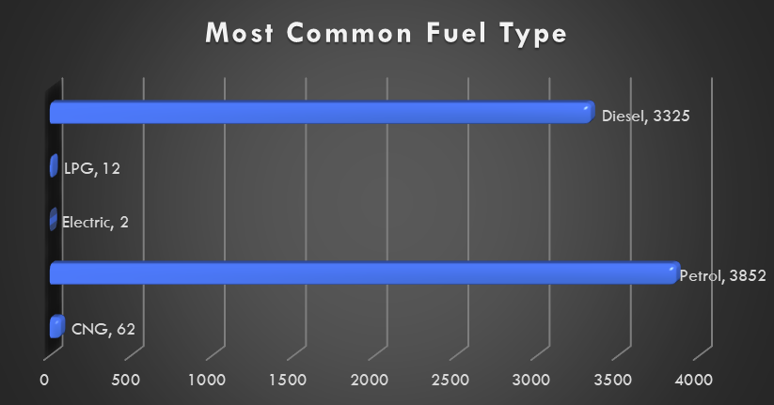
The most common fuel type

Slide 6
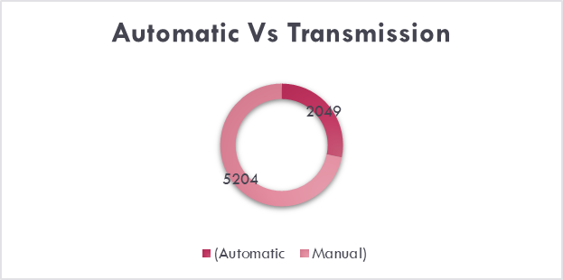
How many cars are automatic vs. manual transmission?
The average mileage of diesel cars
compared to petrol cars

Slide 7

Car which has the highest power output
Car which has the lowest mileage
Lowest Mileage-6.4 Lamborghini Gallardo Coupe
The Avg price diff b/w 1st owner & 2nd owner cars

Slide 8

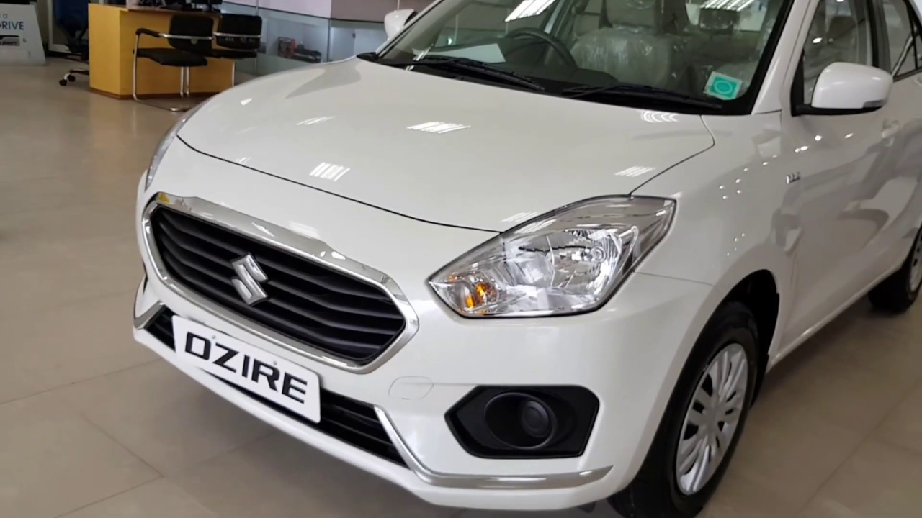
The total number of cars available in Mumbai
979
The brand which has the highest number of cars listed

Slide 9
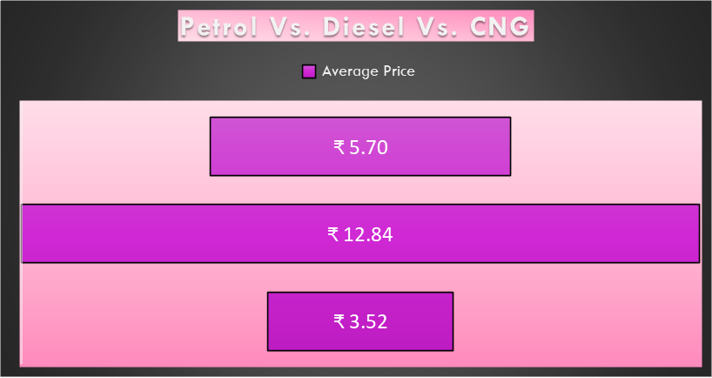
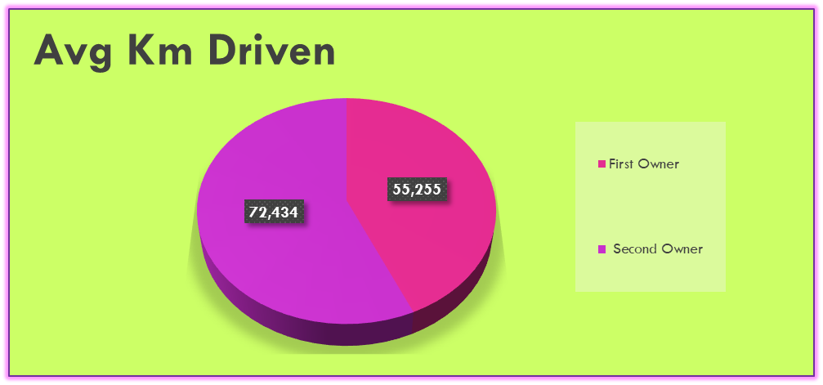
The average price of petrol vs. diesel vs. CNG cars
Petrol
Diesel
CNG
The avg kMs driven for 1st owner vs.
2n owner

Slide 10

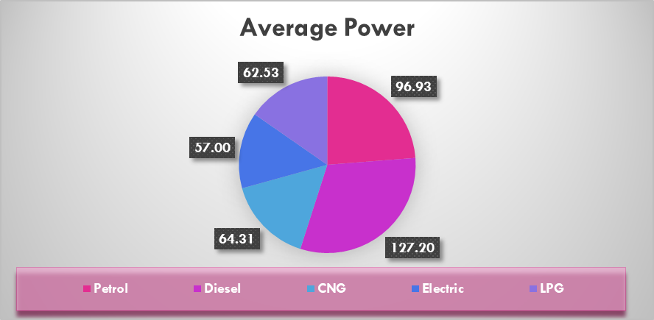
The city that has the highest average car price
COIMBATORE
The average power (bhp) of cars in each fuel type
The average seating capacity of cars in the dataset
5.27

Slide 11
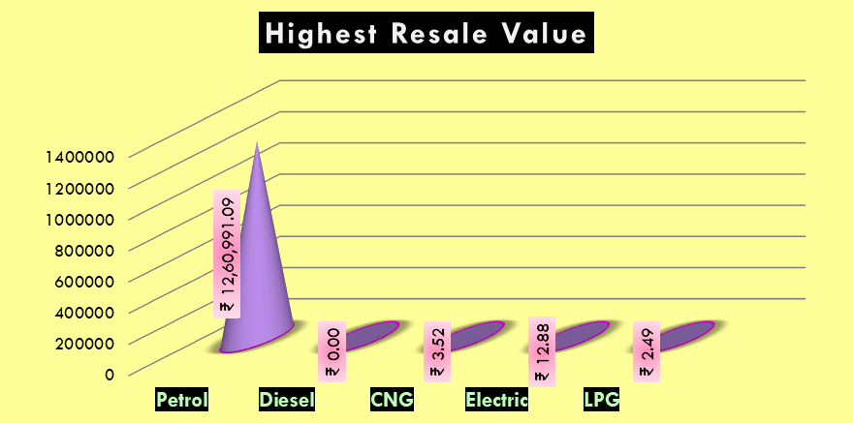
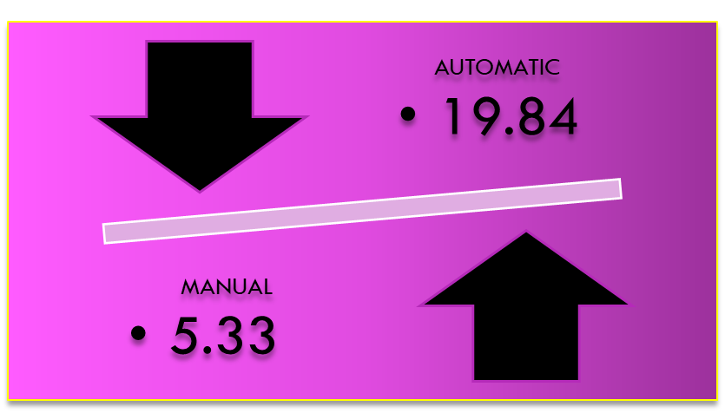
The fuel type that has the highest resale value (avg used car price)
Transmission type that has
a higher resale value on average

Slide 12
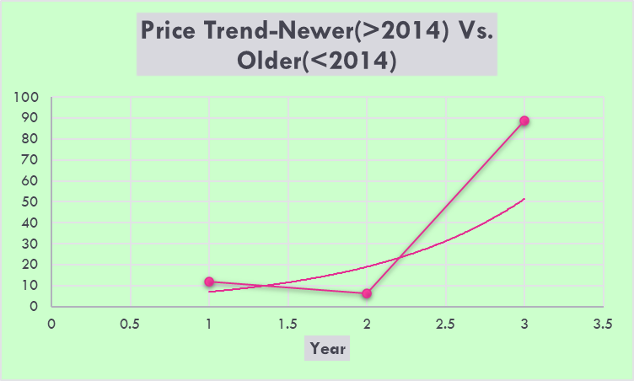
The price trend for newer vs. older cars

Slide 13
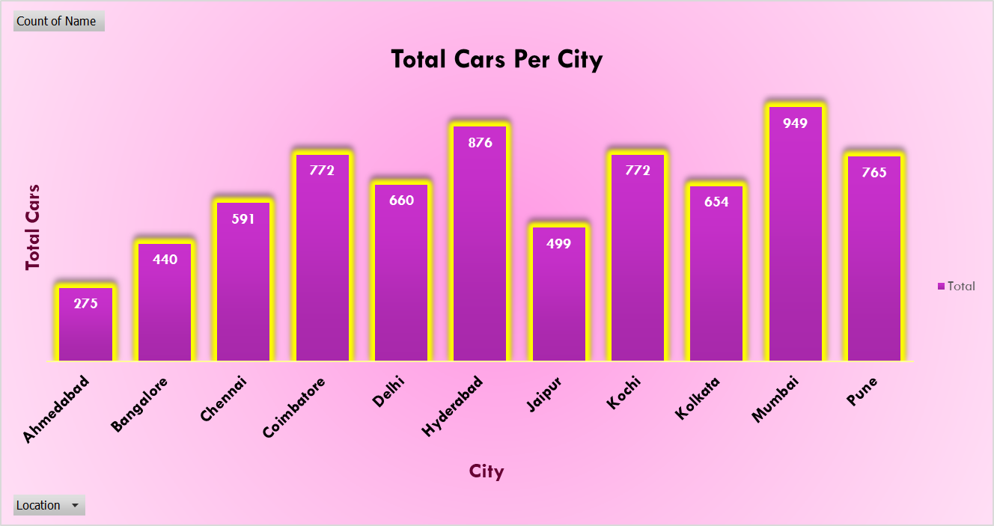
Pivot Table showing the total number of cars per city

Slide 14
Pivot Table showing the sum of prices by fuel type

Slide 15
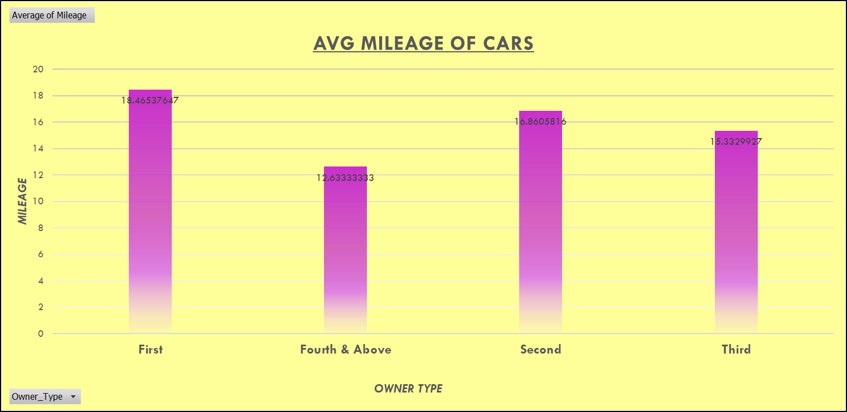
Pivot Table showing the average mileage of cars by owner type

Slide 16
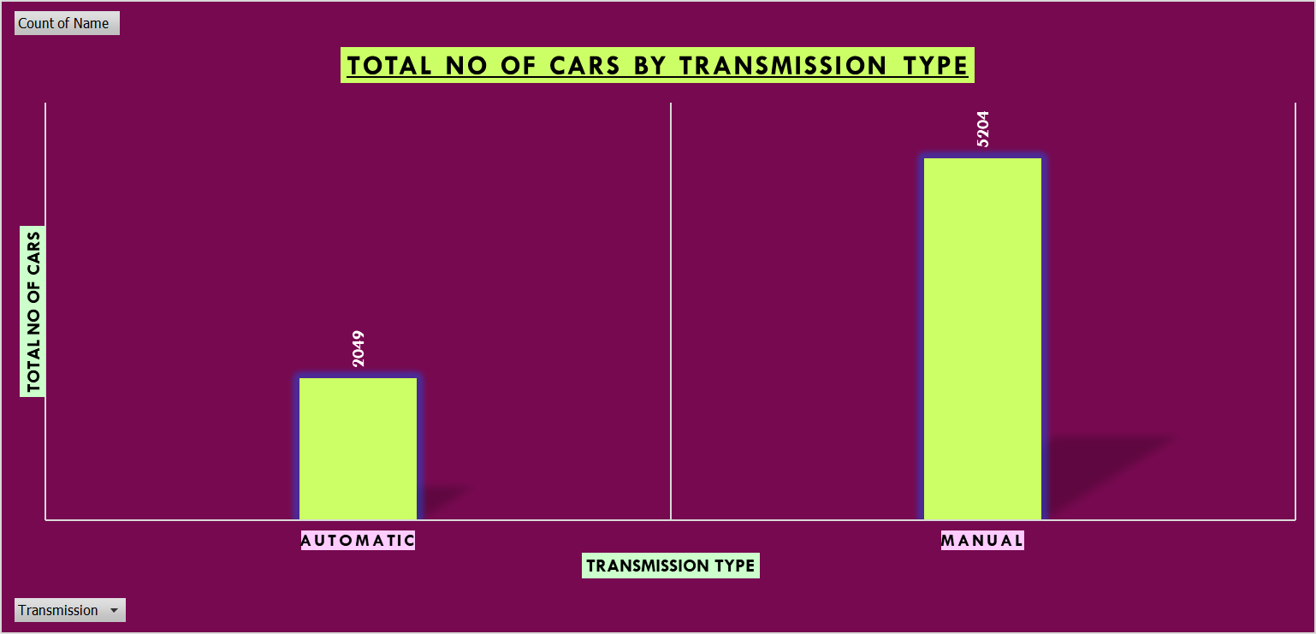
Pivot Table showing the total number of cars by transmission type

Slide 17
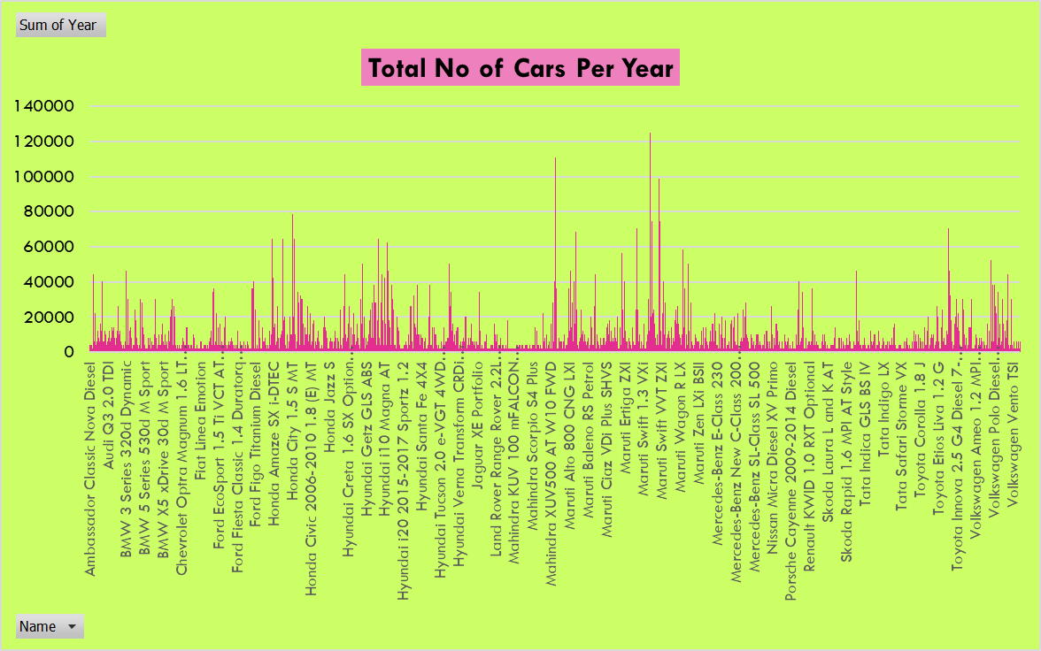
Pivot Table showing the total number of cars per year

Slide 18






How many diesel cars have been driven less than 50,000 km
1362
The total price of all cars in Pune
Average mileage of manual transmission cars
Minimum price of diesel cars
Maximum kilometers driven for a 1st owner car
Number of cars from 2015 or newer

